Slide 1
Year 12
A Parent Introduction to Sixth Form Life
Mr Richard Karran
Twitter= BallakermeenSF
Instagram: ballasixthform
Richard.Karran@sch.im

Slide 2
The Purpose of an Evening like this…
To let you know about the change of ethos and environment between Year 11 and Year 12
To inform you about our expectations, both in terms of studying and how a student presents themselves
To tell you about the student timetable and the extra-curricular responsibilities
To explain the Summer Examinations and the journey towards Year 13

Slide 3
Communication

Slide 4
The Ballakermeen Sixth Form Team
Director of Sixth Form- Mr Richard Karran
Deputy Head of Sixth Form – Mrs Ashely Hall
Assistant Head of Sixth Form – Mrs Sharon Lewin
Assistant Head of Sixth Form – Mrs Ali McMahon-Boyd
Assistant Head of Sixth Form – Mrs Danielle Cummins
Assistant Head of Sixth Form – Mr James McDonald
Assistant Head of Sixth Form – Mr Shawn Sturnick

Slide 6
MRS GILL KIRK
Absences
Holiday Forms
Letters of Confirmation
Attendance and Punctuality
Gill.Kirk@sch.im

Slide 7
MRS ASHLEY HALL
Collaboration with St Ninian’s
The Foundation Programme
Part Time Timetable Students
ahall@online.sch.im

Slide 8
MRS SHARON LEWIN
Work Experience
Careers Advice
On Island Education Providers
sharonlewin@online.sch.im

Slide 9
MRS ALI MCMAHON-BOYD
UCAS and the University System
Unifrog
aboyd@online.sch.im

Slide 10
MRS DANIELLE CUMMINS
Pastoral Care
SEND in the Sixth Form
PSHE in the Sixth Form
Outside Agencies
daniellecummins@online.sch.im

Slide 11
MR JAMES MCDONALD
Attendance/Punctuality
Reports and Tracking
Raising Standards
jamesmcdonald@online.sch.im

Slide 12
DIRECTOR OF SIXTH FORM
Curriculum Issues (Tutor First)
Parent Meetings (2nd Meeting)
Planning and Logistics
Oxbridge/Medics/Vets/Dentists/Teachers
richardkarran@online.sch.im

Slide 13
EXPECTATION

Slide 14
The Sixth Form Routine
School is from 8.45am-3.20pm
Please call in or email when your Son/Daughter is likely to be late or absent. If this doesn’t happen, a truancy call may be received.
For Sixth Form enquiries, please email Gill.Kirk@sch.im, our Sixth Form Administrator
Students receive ‘same day’ late detentions if they don’t make it to school by 8.50am.

Slide 15
Holidays in Term Time
School can only permit 10 days of holiday. The DESC advise us that the rest is ‘unauthorised’.
Please be mindful about taking late August holidays- simply from a logistic point of view. Results day is 17th August.
Driving Lessons/Gym Visits etc. will not count as ‘permitted absence’

Slide 16
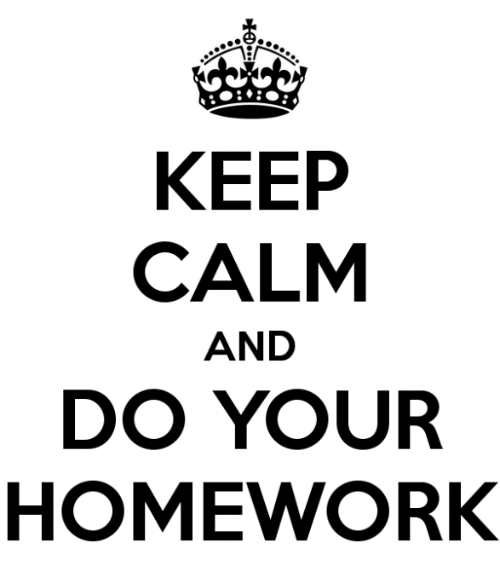
A change of ethos and environment between Year 11 and Year 12

Slide 17
A change of ethos and environment between Year 11 and Year 12

Slide 18
STUDYING OUTSIDE OF SCHOOL
Students will receive six taught lessons a week in each subject.
The lessons taught are just a starting point- if they are not supported by the students’ own additional research and wider reading, the student will not achieve desired progress.
Unlike GCSE, A Level doesn’t have a ‘finish point’. The scheme of work is never over.

Slide 19
THE STANDARDS WE EXPECT
Uniform must be appropriate- We would appreciate your help us with this
Students must be punctual and must stay throughout the school day
Absences must be genuine and allowing students to take days off isn’t helping the school or the student
If students sign out, we must have a telephone call, note or text from the parent. Texts are accepted to the student mobile, as long as we are allowed to see it.
Students are expected to work 3 hours outside their subject per day
We advise against more than 8 hours of paid work a week. Double shifts at the weekend will take their toll.

Slide 20
HOW DO THEY WORK AT HOME?
Re-reading
Re-writing
Copying up notes
Further research in course books or on the internet (70/30)
Completing homework on time and even extending it
Filing/Folder creation

Slide 21
EACH WEEK AT A TIME

Slide 22
USING A PRIVATE STUDY

Slide 23
THE PRIVATE STUDY ZONES

Slide 24
-Different Tracking and - Reporting Dates -Drop Down Days -Revision Sessions -Knowing how to find support staff
Important Points to
know about Collaboration

Slide 25
OUTCOMES

Slide 26
The different types of Sixth Form Qualification Available

Slide 27
Cambridge A Level Examinations
AS (Advanced Subsidiary) sat in Year 12 and A2 (A Level) sat in Year 13
50% of grade from points gained in Year 12, 50% from points gained in Y13
Resit modules from Y12 the following summer if required
The UCAS Predictor grade is taken from the summer AS exam
February Mock Exams
Examples
Business Studies, Economics, Geography, History, Music, Sociology

Slide 28
The Two year A Level exam
The ‘A Level’ grade is derived from the exams sat at the end of the second year.
Our UCAS predicted grade is taken from the Year 12 Summer Exam.
Examples of Two year A Levels at Ballakermeen: Classical Civilisation, English Language, English Literature, Maths, Further Maths, Biology, Chemistry, Physics, French, German, Graphics, Art, Photography, PE, Media

Slide 29
BTEC Courses
Pearson/Ed Excel Courses
Level 3 – A Level equivalent
Continuous assignment assessment, no terminal exams
Graded Distinction Star, Distinction, Merit, Pass
Examples at Ballakermeen: Sport, Performing Arts, ICT

Slide 31
Overview
Access Arrangements
Special Consideration
Contingency Day
Exams Summer 2023

Slide 32
Access Arrangements
Access Arrangements need to be re-applied for at the start of Year 12
Access Arrangements are now subject specific
Access Arrangements can now be withdrawn if students do not use them
Access Arrangements should be the normal way of working – not just in exams

Slide 33
Special Consideration
Special Consideration is a post-examination adjustment to a candidates mark or grade to reflect temporary illness, temporary injury or some other event outside of the candidates control at the time of the exam / assessment which has had, or is reasonably likely to have had an effect on a candidate’s ability to take an assessment or demonstrate his or her normal level of attainment.

Slide 34
Candidates who are absent
Candidates must have completed at least 25% of the total assessment.
Partially completed units are not accepted.
Awarding bodies may reject an application unless supported by medical evidence.

Slide 35
Contingency Day
Wednesday 28th June 2023
Please don’t book / reschedule holidays before this date!

Slide 37
DROPPING SUBJECTS
As you all know when you chose to send your Son/Daughter to Ballakermeen, we do three or four subjects in Year 12
Mid November post tracking
End of Feb post Mock Exams
Summer Year 12 Exams
Subject swapping ended on 30th September

Slide 38
OPTIONS for SEPTEMBER 2023
Students will be advised to drop to three subjects in Year 13.
If a student doesn’t get the required grades to move into Year 13, they will be asked to come to interview with a member of the Sixth Form Team to discuss their options.
U grades will not be able to pass through to Year 13.
If E grade students have the intention to go to Uni, they will be advised to repeat the year.
Students must not begin with a mind-set of Failure

